Slide 1
Sustainable Management of Natural Resources
CHAPTER 16

Slide 2
1. INTRODUCTION
What are natural resources and give some examples:
Natural resources are the basic substances present in nature which are being utilised by the living organisms for their survival.
Some natural resources:
- Water
- Soil
- Forest
- Wildlife
- Coal
- Petroleum
Notes:
Living in harmony with nature' is not new to us. Sustainable living has always been an integral part of India's tradition and culture.
Natural resources are the basic substances present in nature which are being utilised by the living organisms for their survival.
Some natural resources like water, soil, forests, wildlife, coal, petroleum, etc., should be utilised in a sustainable manner in order to conserve our environment.

Slide 3
Three R’s to save the environment:
Reduce
Reuse
Recycle
Notes:
We can adopt the 3 R’s – Reduce, Recycle and Reuse, to save our environment.
(i) Reduce involves the less use of resources.
(ii) Recycle involves recycling of used items like plastic, paper, glass, metal, etc., and convert them in to new items.
(iii) Reuse involves using things again and again.

Slide 4
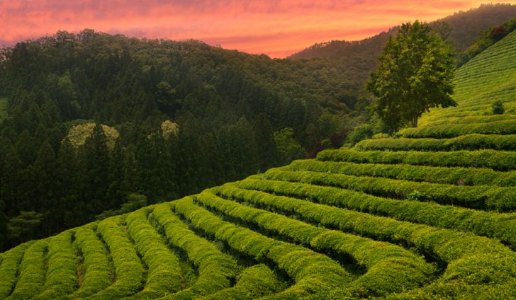
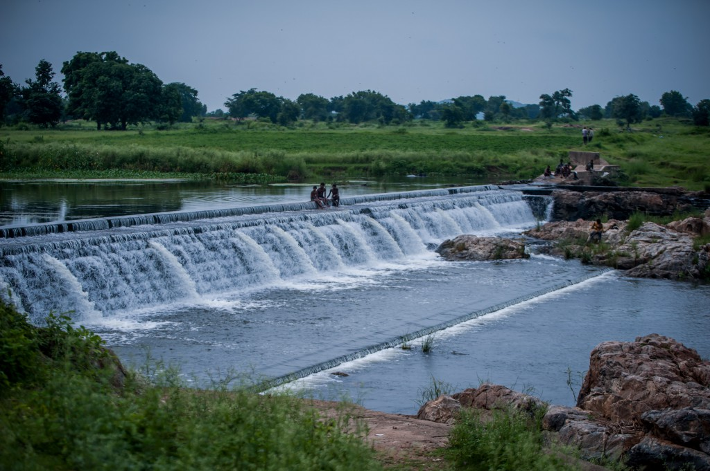
Why do we need to manage the resources?
Resources are present in limited quantity
Demand of resources are increasing
Hazardous effects of excessive use of resources
Notes:
We need to manage the resources because they are present in limited quantity. With the increase in population, the demand for resources are increasing. So, there is a need to manage the resources to minimize their use and preventing the exploitation of resources.

